Slide 1
Learning Management System
By: Kyle Vessey, Brandon Popson, Nhat Nguyen,Joshua Reese and Hung Ngo . Using “Ruby on Rails”

Slide 2
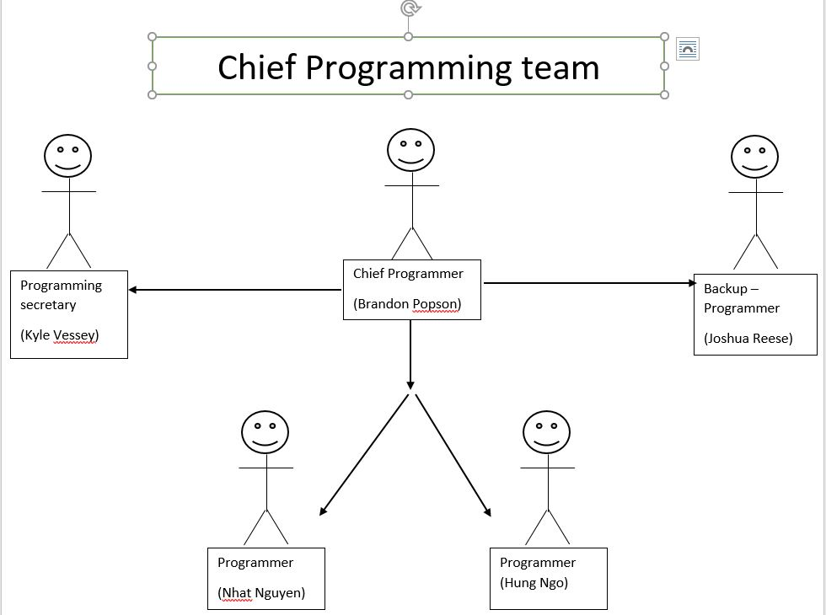
Team organization

Slide 3
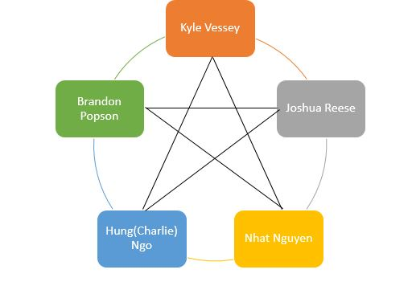
Team Model – (Democratic)

Slide 4
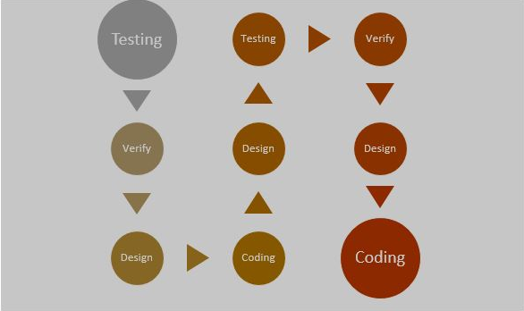
Iterative Life cycle

Slide 5
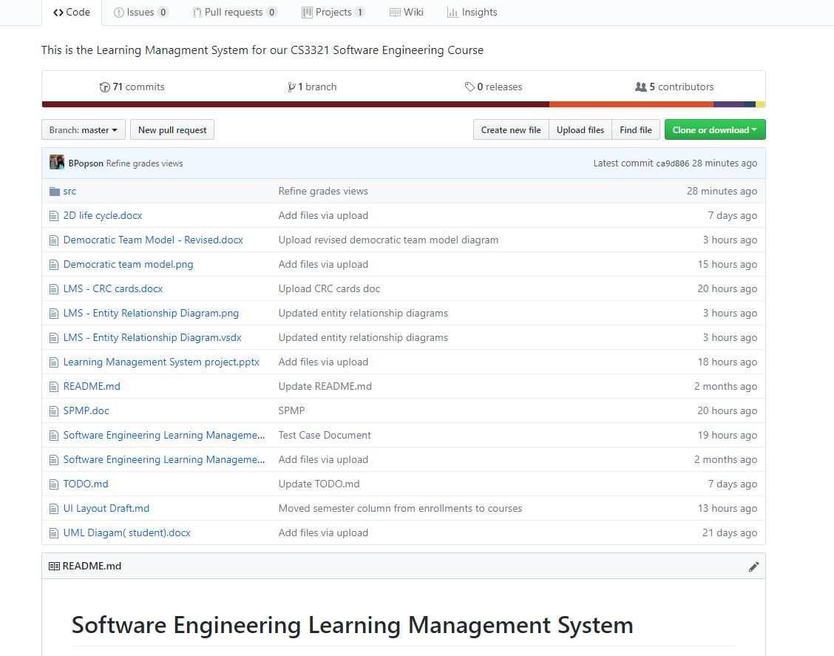
GitHub

Slide 6
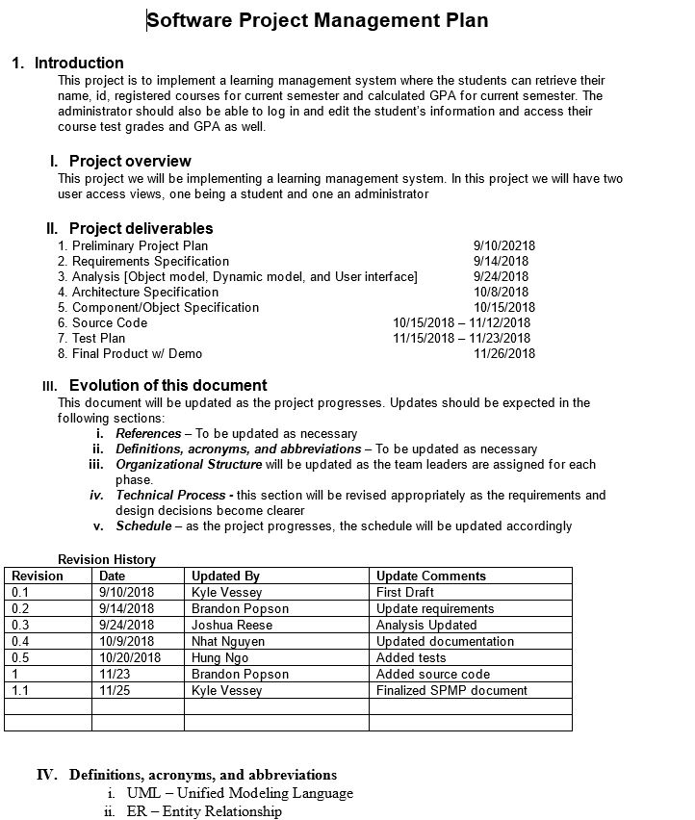
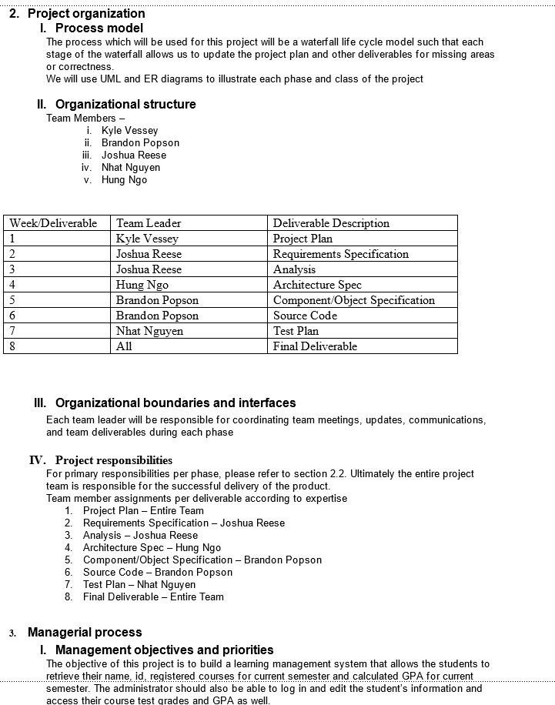
Software project management plan

Slide 7
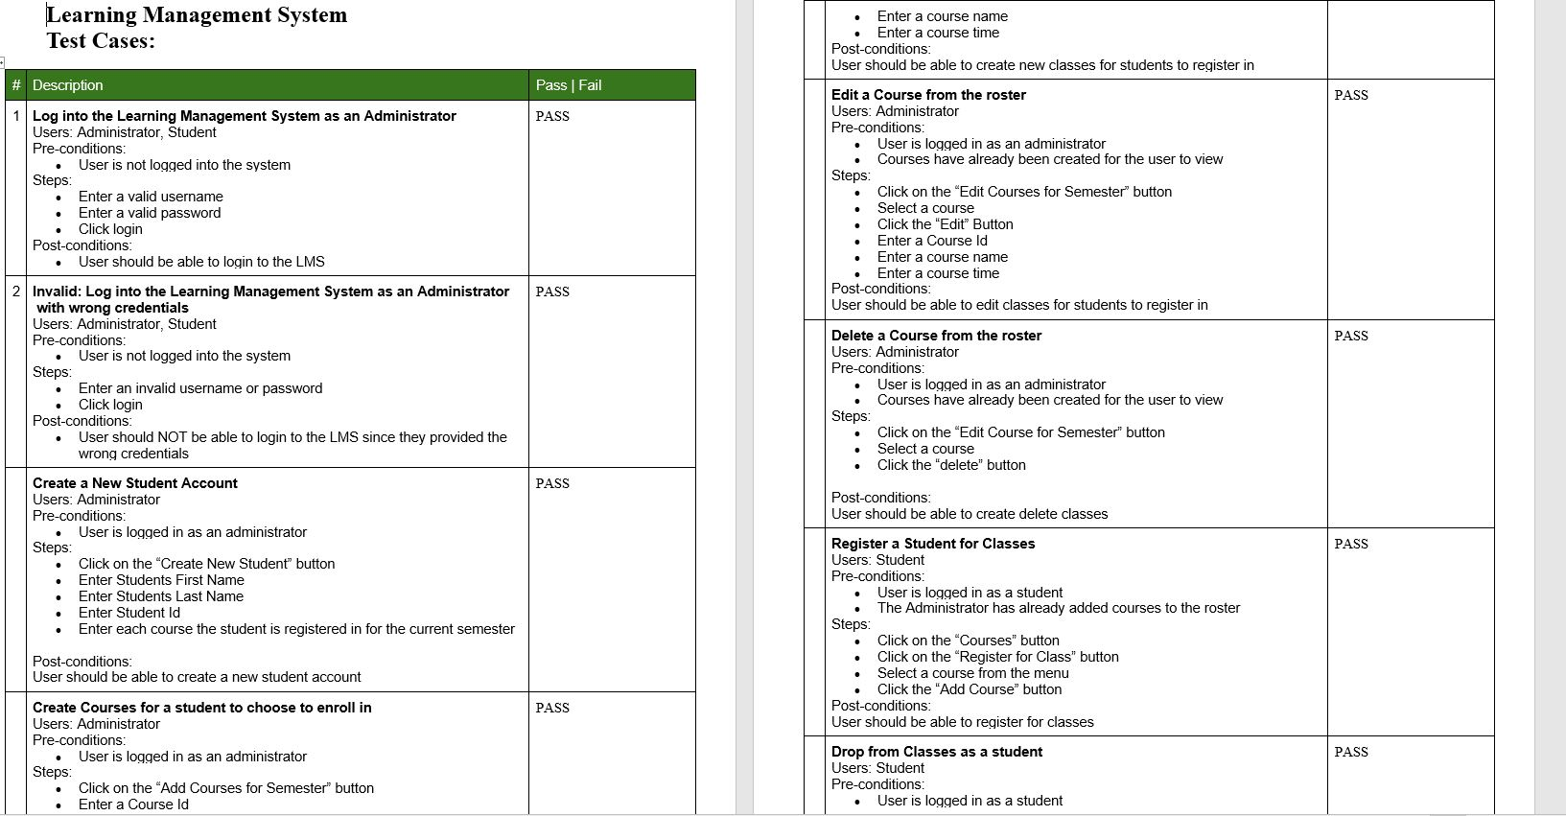
Test Case

Slide 8
Show requirement and analysis workflow related artifacts used in this project. For example, use-case diagrams, software project management plan, prototype for identifying basic requirements, and so forth.

Slide 9
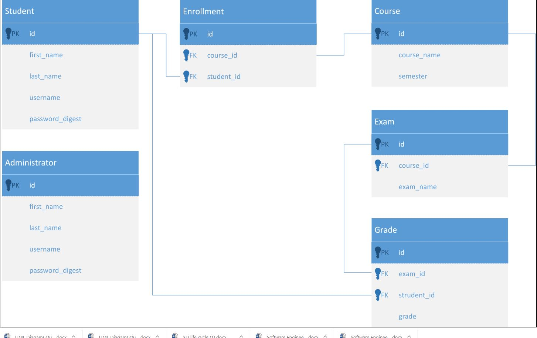
Relationship Diagram

Slide 10
Show design and implementation workflow related artifacts used in this project. For example, class diagrams, interaction diagrams, sequence diagrams, CRC cards, source codes, and so forth.

Slide 11
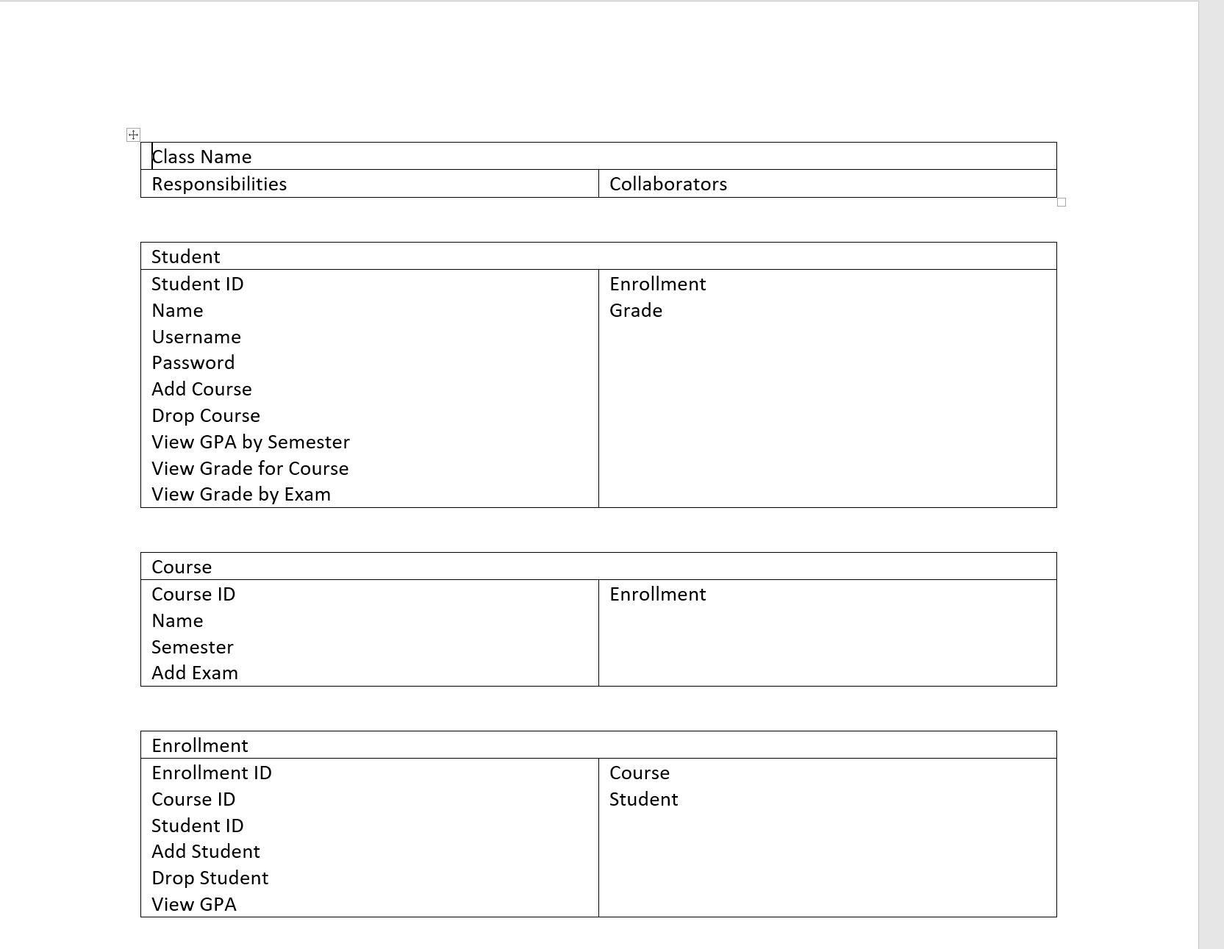
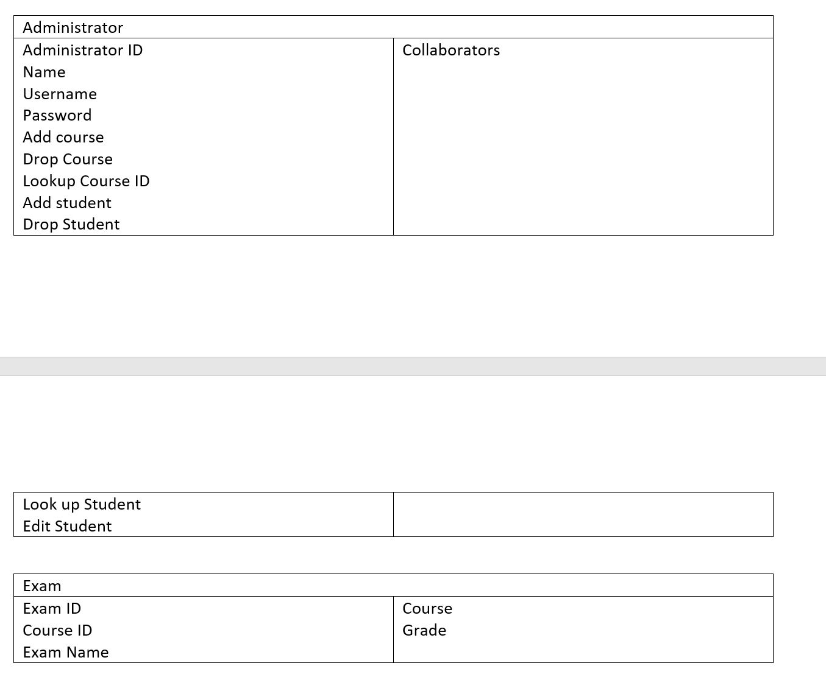
Class-responsibility-collaboration (CRC) cards

Slide 12
(5) Show test workflow related artifacts like unit test cases, integration test, product test, and so forth.

Slide 13
Hyper link
(6) Run your software like user login, course add-in/drop-off, GPA calculation, user adding/deleting, course management, and so forth.

Slide 14
Fin

